Slide 1
Ethics in Modern Data
Bias, Transparency, Impact
Christine Assaf, People Solutions Consultant
William Assaf, Principal Consultant in Analytics
Notes:
C
Hi, Welcome to Ethics in Modern Data. My name is Christine Assaf
I’m William Assaf.
Today we’re going to talk about Bias, transparency, and the impact of ethics in modern data.

Slide 2


Christine Assaf
Human Resources
Leadership Development, Organizational Development, People Strategies, Training & Development
I/O Psychology
Current grad student; The study of behavior of individuals and groups in the workplace to determine how to improve performance and productivity
People Solutions Consultant
HRTact.com
Speaker/Trainer
/christineassaf
Communication, Management, Leadership, Team Building, and more
@hrtact
Notes:
C
First, a bit about me. I’m a People Solutions Consultant. My background is in Human Resources. I currently study I/O Psychology and I’m a frequent speaker and facilitator events like these across the country.

Slide 3

William Assaf
SQL DBA
SQL Server MCSE, author of SQL Server certification exams for Microsoft since 2012. Principal Consultant and Manager in Sparkhound Analytics Practice.
Author, SQL Server Inside Out
Principal Consultant, Analytics
Lead of author team for Microsoft Press SQL Server Inside Out 2017 and 2019.
SQLTact.com
PASS Regional Mentor, Organizer
/williamdassaf
Organizer of SQL Saturday Baton Rouge, Baton Rouge SQL Server User Group, PASS Regional Mentor for US South Central Region.
@william_a_dba

Slide 4
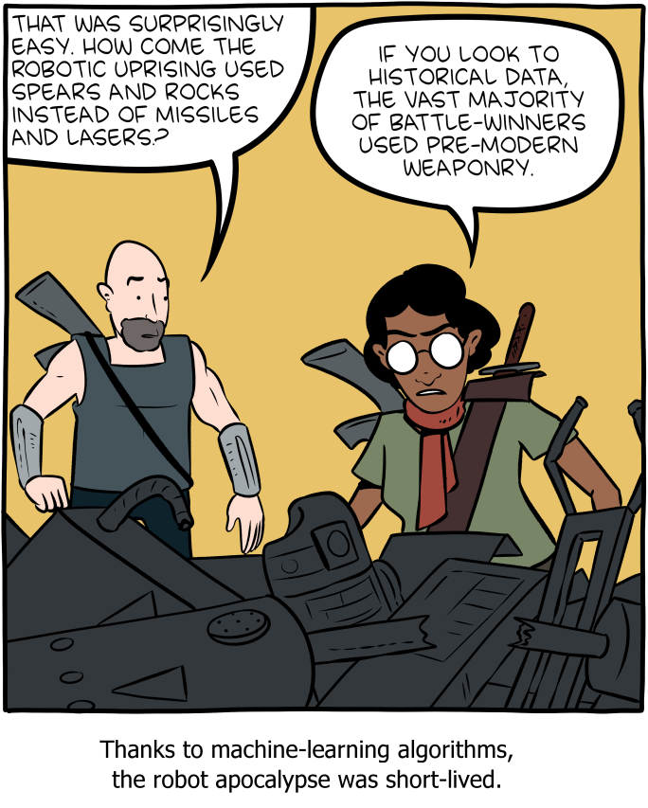
Historical Bias
Image: https://www.smbc-comics.com/comic/rise-of-the-machines
Notes:
WILLIAM
Today we are going to be talking about bias in data analytics and data collection, what we can to do recognize our own bias and fight the perception of bias, and on how bias in data has real impacts in our society.
But without context, without understanding historical or time-based biases, both we and our data findings are doomed to parrot bias.

Slide 5
Bias
Notes:
C
If trained on data which contains human bias, then of course our data outcomes will learn bias.
Worse, they are likely to amplify it, institutionalize it, and mask it in the trustworthiness of an “algorithm.”

Slide 6
Bias
“Bias is an inaccuracy which is systematically incorrect in the same direction.
Many algorithms which are trained to do a human job will have been trained on human generated data … This is a huge problem, especially if people assume that algorithms are impartial and can’t hold the same biases as people do.”¹ - Laura Douglas
¹ https://medium.com/@laurahelendouglas/ai-is-not-just-learning-our-biases-it-is-amplifying-them-4d0dee75931d
Notes:
C
Laura Douglas an AI researcher defines bias as… <read quote>
This presentation is about acknowledging both the public’s perception of the trustworthiness of statistical analysis, and also our responsibilities as data professionals and analysts.
This presentation is about our ethical responsibilities as data professionals to become aware of bias, acknowledge it, and be accountable for it.

Slide 7
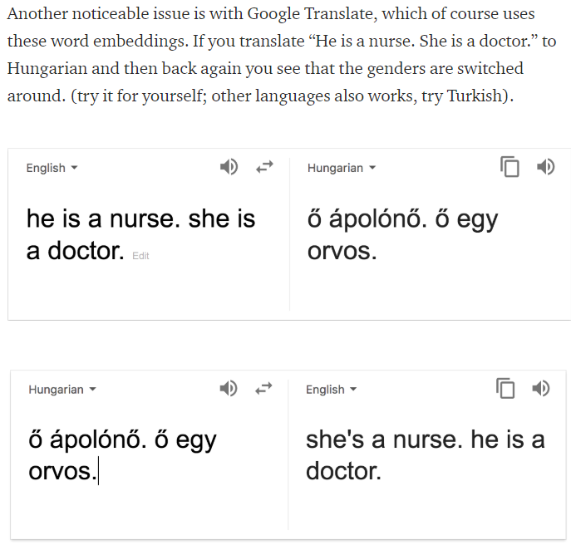
Bias
https://medium.com/@laurahelendouglas/ai-is-not-just-learning-our-biases-it-is-amplifying-them-4d0dee75931d
Notes:
C
Here’s an example of bias… This is from Google Translate.
See here he is a nurse, she is a doctor,
<animation>
but reverse the translation, and the gender norms are reversed.
Biases are “live on display” in the wild. Try it yourself with a number of languages, this works for Hungarian and Turkish to English.
This is only helping to further society’s implicit biases, in this case, on gender norms in professions.

Slide 8
Historical Bias
Without awareness of historical bias in source data, you will present unethical findings at best.
Bias exists. It must be identified and acknowledged.
Let’s look at a few examples…
Notes:
C
<read notes> Without awareness of historical bias in source data, you will present unethical findings at best.
Bias exists. It must be identified and acknowledged.
Conclusions drawn based on biased data, without caveats, statistical controls, and historical context, may be highly unethical.
Let’s look at some more examples of that…

Slide 9
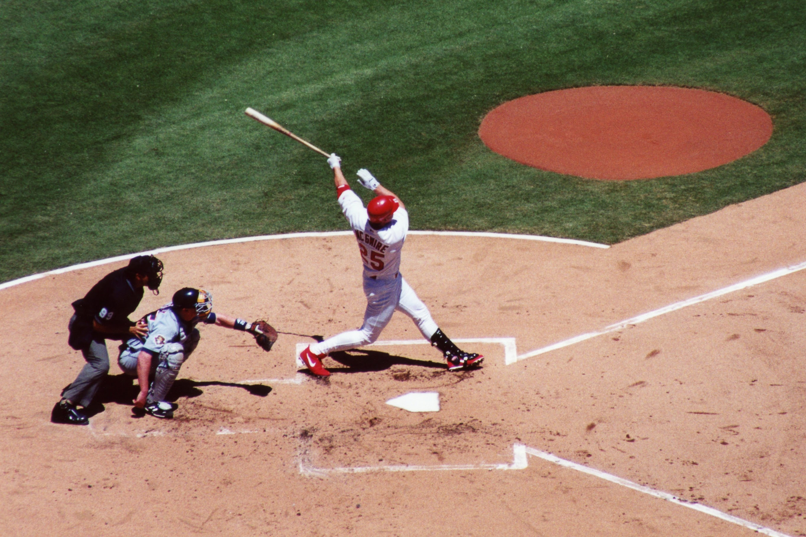
MLB’s Steroid Era
Widespread use of steroids in the late 1990’s and early 2000’s set many new home run records.¹
“There was a significant increase in players who hit more than 40 HR in a single season during the steroid era compared to before and after.”²
¹ https://bleacherreport.com/articles/480826-the-steroid-eras-destruction-of-major-league-baseball
² https://www.omicsonline.org/open-access/the-effect-of-the-steroid-era-on-major-league-baseball-hitters-did-it-enhance-hitting-2161-0673-1000161.php?aid=53354
³ http://www.espn.com/mlb/topics/_/page/the-steroids-era
Image: https://en.wikipedia.org/wiki/Mark_McGwire#/media/File:Mark_mcgwire.jpg
Notes:
WILLIAM
<read slide>
Widespread use of steroids in the late 1990’s and early 2000’s set many new home run records.
“Though steroids have been banned in MLB since 1991, the league did not implement leaguewide PED testing until 2003.”³
The top 6 HR single seasons in history were all between 1998-2001, all by three players, Barry Bonds, Mark McGwire, Sammy Sosa.
This significant increase in players who hit more than 40 HR in a single season, and knowledge of the illegal actions, affects our historical analysis of:
training techniques,
scouting,
coaching,
Hall of Fame eligibility,
long-term player health,
player compensation,
or stadium batting statistics
must ethically consider the illegal player behavior during the legal steroid and unmonitored use era

Slide 10
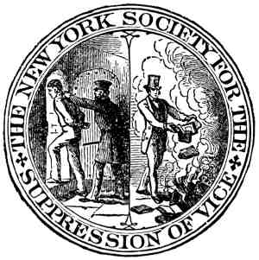
Censorship
U.S. Comstock Law (1873-1957) banned “obscene, lewd, or lascivious” materials.
The 1980s ushered in a new push to libraries, school boards, and government agencies to censor books.¹
Mid-20th century libraries experienced “cultural censorship of: racism, sexism, nudity, religion, and evolution.”²
“Media almost invariably yield to pressure… and establish some sort of code of self-regulation.”³
¹ https://lithub.com/the-history-and-present-of-banning-books-in-america/ ² https://journals.sagepub.com/doi/pdf/10.1080/03064228808534489
³ https://scholarship.law.wm.edu/cgi/viewcontent.cgi?article=1897&context=wmlr ⁴ Tebbel, John William. 1975. “A Brief History of American Bookselling.”
Image: Public Domain due to age
Notes:
WILLIAM
<read notes>
The U.S. Comstock Laws (1873-1957) banned “obscene, lewd, or lascivious” materials.
<next>
The 1980s ushered in a new push to libraries, school boards, and government agencies to censor books.¹
<next>
Mid-20th century libraries experienced “cultural censorship of: racism, sexism, nudity, religion, and evolution.”² In fact the American Library Association in 1984 “discerned a 'continuing pattern' of suppression of information” from the government.²
<next>
And the “media almost invariably yield to pressure… and establish some sort of code of self-regulation.”³ and a sense of self-preservation.
This affects our analysis of book publication/sales, readership, popularity, even trademark conversations must be aware of quote “censorship placed on the industry from religious groups, patriots, unions, private businesses…”⁴, and of course the government. Just because publications weren’t sold or available, doesn’t mean the publications didn’t exist, or that there wasn’t public interest in them.
By the way, the Comstock laws also prohibited the mailing and sale of contraceptives, and it was not until 1972 that the United States Supreme Court legalized birth control for all citizens, irrespective of marital status. This affects our historical data sources on all sorts of data on
birth rates,
reproductive health history,
family planning choices,
family size preference,
and public health policy.

Slide 11
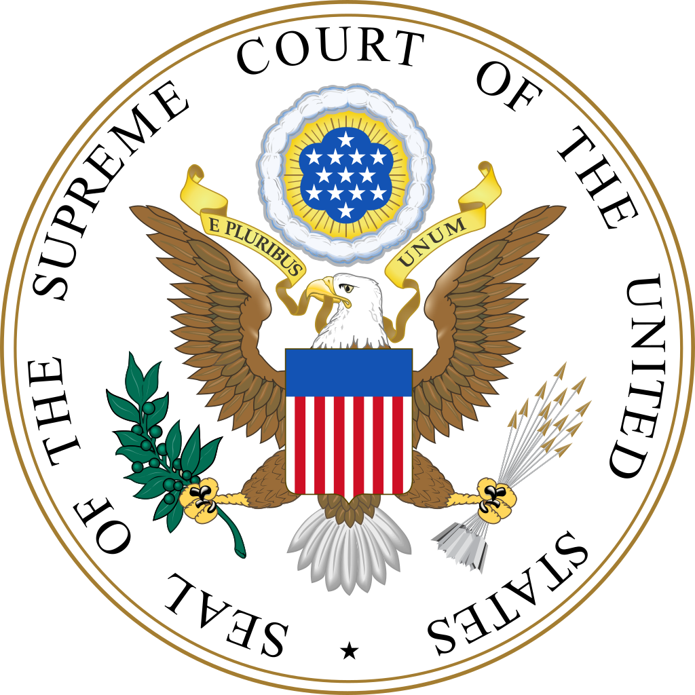
Bias in Judicial Sentencing
A 1992 review revealed “both ethnic and gender biases in sentencing where judges have discretion, but no biases where discretion is limited.”¹
Sentences for Black males in the federal system are nearly 20 percent longer than those for white males convicted of similar crimes.²
¹ https://onlinelibrary.wiley.com/doi/pdf/10.1002/bsl.2370100205
² https://www.aclu.org/sites/default/files/assets/141027_iachr_racial_disparities_aclu_submission_0.pdf
Image: public domain
Notes:
WILLIAM
<read notes>
There is significant, historical and modern day evidence for race-based bias in federal judicial sentencing.
A 1992 review revealed “both ethnic and gender biases in sentencing where judges have discretion, but no biases where discretion is limited.”¹ Another study in 2014 found that sentences for Black males in the federal system are nearly 20 percent longer than those for white males convicted of similar crimes.²
The data speaks to two different potential causes.

Slide 12
Bias in Judicial Sentencing
What determines these outcomes? Two factors.
United States v Booker in 2005 and Gall v United States in 2007 gave federal judges more discretion on sentencing.
Studies found “disparate racial outcomes in almost every stage of prosecutorial discretion.”^{1,2,3}
¹ https://www.ussc.gov/sites/default/files/pdf/research-and-publications/research-publications/2017/20171114_Demographics.pdf
² https://orgs.law.harvard.edu/acs/2016/02/08/racial-bias-and-prosecutorial-discretion/#_ftn2
³ https://repository.law.umich.edu/cgi/viewcontent.cgi?referer=&httpsredir=1&article=2413&context=articles
⁴ https://www.fd.org/sites/default/files/criminal_defense_topics/essential_topics/sentencing_resources/fact_sheet_-_ussc_report_on_racial_disparity_is_flawed_and_being_misused_-_january_2018_-_final.pdf Image: public domain
Notes:
WILLIAM
<read slide after Two Factors>
Bias in both sentencing discretion by judges and prosecutorial discretion by attorneys general contribute to outcomes resulting in racial disparities in our criminal justice system.
<next>
Perhaps accounting a judge’s discretion, “Charges with mandatory minimums are disproportionately charged against Black defendants.”⁴
<next>
Analysis of severity and length of sentencing, acquittals, prosecutorial effectiveness, evidence collection, interrogation techniques, must take into account biased outcomes on race.
Analysis without this historical context would only reinforce and institutionalize racial bias.

Slide 13
Overcoming Bias
Notes:
C
How would be go about identifying and overcoming bias?

Slide 14
Identifying Bias
Understand that bias in data collection and analysis may be inevitable, but is not acceptable.
You have an ethical responsibility to acknowledge, control for, and not further bias.
Look at bias outcomes, not in intents or origins.
Outcomes are how bias is measured.
Notes:
C
<read notes>
Data collection is usually provided to us through real-world interactions. Which means that it may contain real-world bias. No data exists in a vacuum.
Understand that bias in data collection and analysis may be inevitable, but is not acceptable.
It’s not your responsibility to end bias (though that’s a worthy cause) – but rather to be aware of it.
You have an ethical responsibility to acknowledge, control for, and not further bias.
<next>
Look at bias outcomes, not in intents or origins.
Outcomes are how bias is measured.
The world doesn’t care if we intended to be un-biased. It cares that we either were or were not biased – so it’s all about the outcome.

Slide 15
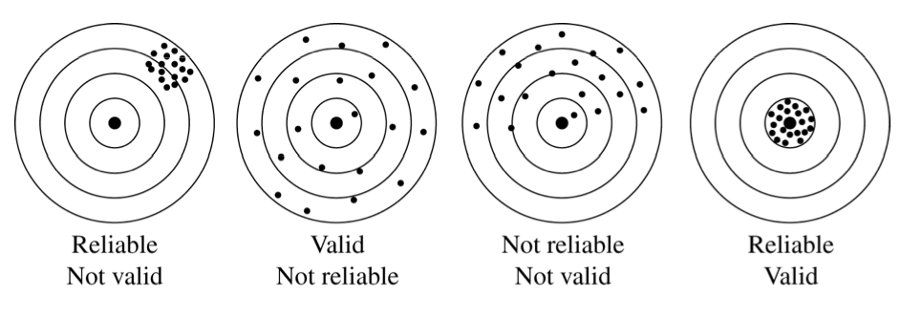
Validity & Reliability in Data
What is validity?
What is reliability?
Notes:
C
<read notes>
Part of our ethical responsibility is looking at our methodologies and processes with data and knowing it’s statistical accuracy and inaccuracy.
Let’s look at some statistics 101. First we’ll start with What is validity? And What is reliability? Validity is the extent to which a concept, conclusion or measurement is well-founded and likely corresponds accurately to the real world.
Valid derived from Latin to mean “strong.” We’re pretty sure this is not just made up – it actually exists out there and tells a story of something true. But more importantly validity means – we sought out to answer a question (bullseye) and we’re pretty sure this data, this system, this analysis answers that “real-world” question.
Reliability – consistency, we can do this test, run this system, predict this thing happening over and over again and we know it to be true; “have confidence in the results”

Slide 16
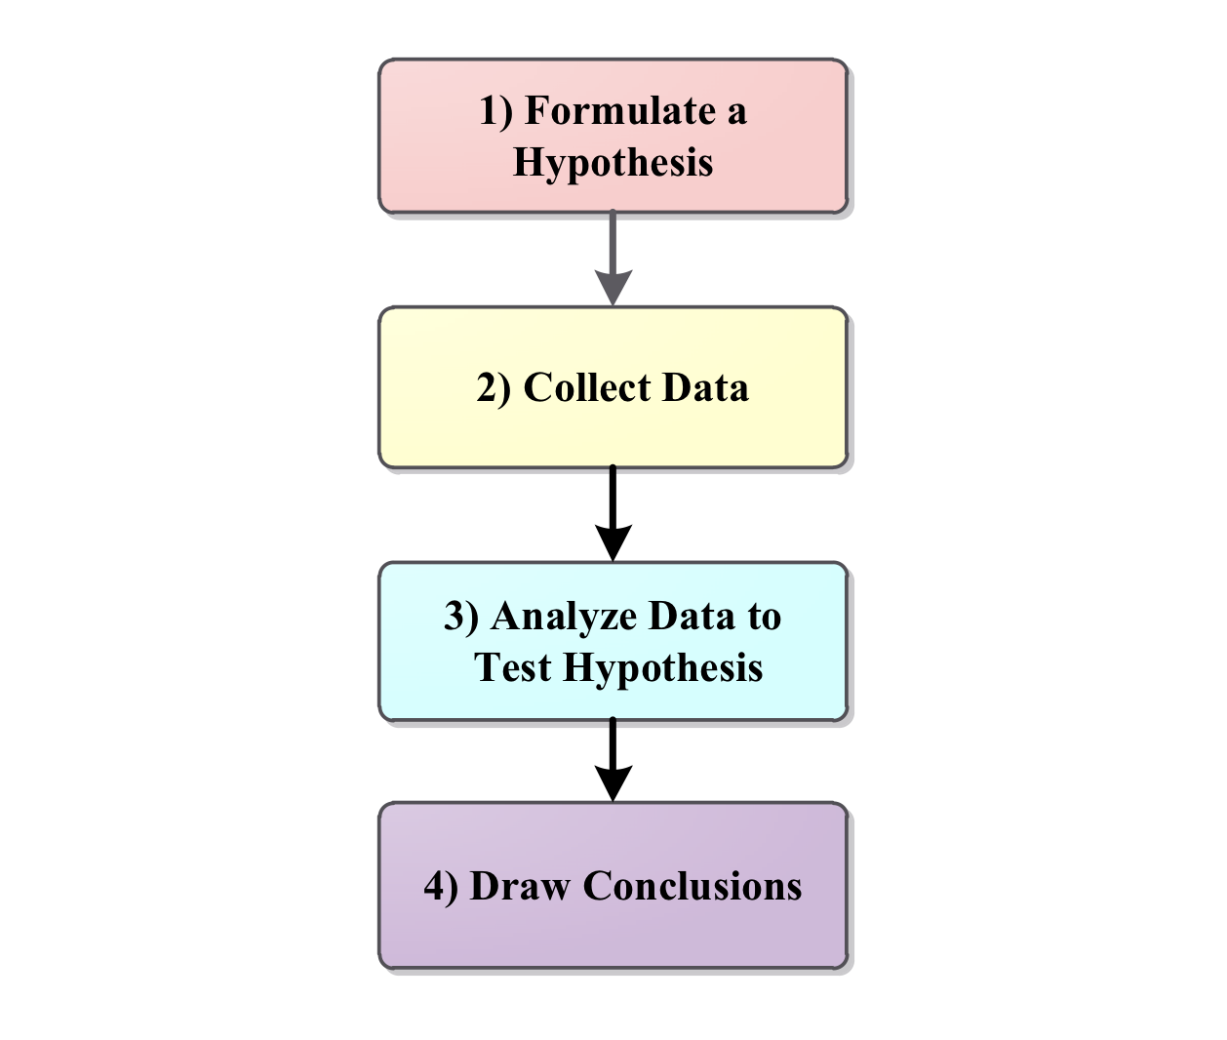
Validity & Reliability in Data
How do we prove something we’ve gathered is valid and reliable?
Hypothesis testing!
Can we truly say our data was valid or reliable?
Notes:
C
<read notes>
So how do we prove something we’ve gathered is valid and reliable?
Through hypothesis testing!
If our collection methods lack credibility,
or our analysis fails to see variables, then can we truly say our data was valid or reliable?
But how can we overcome what we don’t know? There’s a few ways:
“independent verification” by consultants or other business entities
SMEs, outside perspectives, third-party analysis
Or simply more diversity of thought in our analysis, which means including people on our teams who have different life experiences than our own, who can give us insights into variables we may have missed… <more on that in the next slide>

Slide 17
Diversity Aids Validity, Counters Bias
“It’s difficult to build technology that serves the world without first building a team that reflects the diversity of the world… A more diverse group of researchers and engineers is more likely to recognize and think harder about bias problems that may even impact them personally.”¹ - Brad Smith, Microsoft, President
¹ Smith, Brad. Tools and Weapons, 2019
Notes:
C
<read notes>
Brad Smith with Microsoft once wrote…<read quote>
In IT we know we need complex teams to solve complex problems. We know diverse teams are more productive.
Let’s look at some more examples of bias…

Slide 18

Facial Recognition Technology
“Four out of five people (81%) identified by the Metropolitan Police’s facial recognition technology as suspects are innocent.”^{1,2} “…falsely identified African-American and Asian faces 10 to 100 times more than Caucasian faces.”³
In a test of Amazon’s “Rekognition,” 28 members of Congress were incorrectly matched as other people who have been arrested for a crime.⁴
1 https://www.theguardian.com/technology/2020/jan/24/met-police-begin-using-live-facial-recognition-cameras
2 https://news.sky.com/story/met-polices-facial-recognition-tech-has-81-error-rate-independent-report-says-11755941?
3 https://www.nytimes.com/2019/12/19/technology/facial-recognition-bias.html
4 https://www.aclu.org/blog/privacy-technology/surveillance-technologies/amazons-face-recognition-falsely-matched-28
Notes:
C
<read notes>
This isn’t the first time we’re gonna mention facial recognition products in this presentation.
In the UK four out of five people (81%) were identified as suspects by the Metropolitan Police’s facial recognition technology, but were innocent.
Also this same technology falsely identified African-American and Asian faces 10-to-100 times more than it did for Caucasian faces.
In a test of Amazon’s “Rekognition,” 28 members of Congress were incorrectly matched as other people who have been arrested for a crime.
Without validity or reliability, is it ethical to use a facial recognition software that has pervasive access to public camera systems? (No)
And do we think that law enforcement be transparent and open about the flaws in such a system? (No)
We’re going to talk more about the need for transparency.

Slide 19

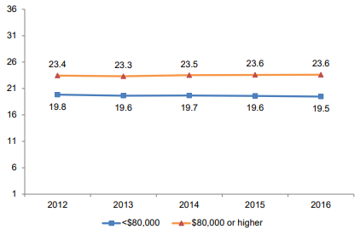
The ACT Test
Measures what students learned in school (valid).
Repeated testing gets similar results (reliable).
In 2016, ACT admitted Family Income explains performance on their test.¹
“More than 1,000 [colleges] have adopted test-optional admissions policies.”²
1 https://www.act.org/content/dam/act/unsecured/documents/R1604-ACT-Composite-Score-by-Family-Income.pdf 2 https://www.usnews.com/news/the-report/articles/2018-10-26/the-new-opt-out-movement-colleges-make-entrance-exams-optional 3 https://www.act.org/content/dam/act/unsecured/documents/5688-data-byte-2016-5-adjusted-differences-in-act-scores-by-family-income.pdf 4 Image: Corporate logo on ACT.org
Notes:
C <read notes>
Many of us are familiar with The ACT Test which is an exam most high schoolers take as part of their college application process.
ACT has long since stated that the test measures what students learned in school (which means it’s valid). And that repeated testing (if a student takes it over and over again) they’ll get similar results (which means its reliable).
However, in 2016, ACT admitted that family income is a major factor on their test. There is a three to four point difference between students in a home that earns less than eighty thousands per year, and a home that earns more. That the gap is widening, according to their own data.
Credit to ACT for disclosing the research here which shows a widening gap among students based on family income.
Later, they tried to explain this gap by indicating that lower-income students also had “lower high school GPAs and less rigorous coursework.” Again, credit to them for at least acknowledging this, but is the ACT ethically testing for high school achievement, or, for opportunity?
If our measurements are valid and reliable, but outcomes are rejected, should we challenge our testing?
Our results are valid as tested, but what about the outcomes? Are they ethical? Are they to be trusted as the result of an impartial algorithm? Should we not look for covariate or confounding variables?
Can anyone think of some other variables that may affect a student’s ACT score?
In this ACT example, socioeconomic level is a variable – it affects the outcome.
Tutoring?
Home schooled? Public school? Private school?
Number of miles from a large city
Amount of sleep the student got before the exam
Male vs female
Number of hours they work a PT job
Recently, more than 1,000 institutions of higher learning have adopted test-optional admissions policies. Meaning they no longer ask for the ACT or SAT on applications. This might question the validity of ACT’s test in terms of what colleges want out of the score, given that so many schools disregard its validity.
An overwhelming amount of studies have been done that say the ACT does NOT predict college graduation outcomes. In fact, the biggest factor that impacts graduation outcomes remains household income. (sarcastically) So why not toss the test and just accept students with high household income?

Slide 20
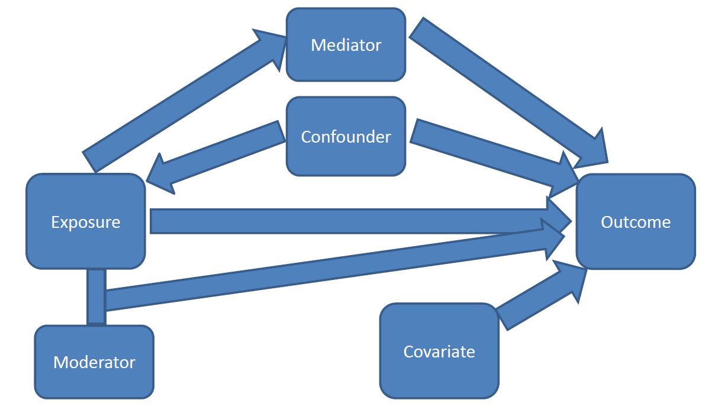
Knowing the Variables
Mediator
Confounder
Moderator
Covariate
You will never find the variables unless you’re looking for them.
Ask: “Are there any other variables that affect the data?”
https://significantlystatistical.wordpress.com/2014/12/12/confounders-mediators-moderators-and-covariates/
Notes:
C
<read notes>
Knowing the variables that are involved in your analysis is important – just as we saw with the ACT.
When conducting analysis, most researchers will review, identify, and map out the variables.
Let’s briefly go through the definitions of some variables and then I’ll give an example that will make the clearer.
First, understand that mediators and confounders are similar except for the affect or direction they have on exposure and outcome.
Confounders affects both exposure and outcome.
Mediators are considered to be “the causal pathway” between exposure and outcome. Which means they seem to naturally occur.
Moderators are simply interactions that change the size or direction of the effect of the exposure on outcome. It makes the outcome smaller or larger.
And Covariates are variables that might affect outcomes but really are not associated with anything else.
You will never find the variables unless you’re looking for them.
Ask yourself: “Are there any other variables that affect the data?”
There will always be other variables made apparent when you dig. Sometimes you never see them until after your data collection is complete.
Now let’s look at an example…

Slide 21
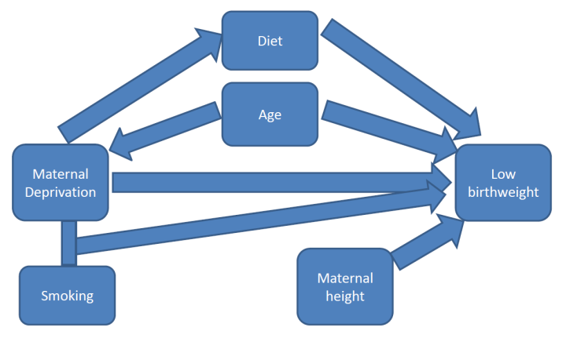
Mediator:
Diet
Confounder:
Age
Moderator:
Smoking
Covariate:
Maternal height
https://significantlystatistical.wordpress.com/2014/12/12/confounders-mediators-moderators-and-covariates/
Notes:
C
<read notes>
We’re going to look at the relationship between poor mothers (shown here as “maternal deprivation”) and low birthweight. We know this to be true. Maternal deprivation (Poor mothers) give birth to babies with lower birthweight. It’s been tested over and over again.
But why? What are the variables that surround it?
Let’s look at our variables…
Mediator here is diet. Remember Mediator is the “the causal pathway” it’s said to be “naturally occurring”. In this case diet could be due to being poor, and a sub-optimal diet of the mother who is nourishing the unborn child means the baby would be smaller. Usually a mediator variable is something you can’t avoid in your data. It exists and you just need to be aware of it.
The confounder variable is age here. Remember that confounders affect both the exposure (poor mothers) and the outcome (low birthweight). In our analysis Maternal age may affect poverty (perhaps the younger a mother is, the less money she has, or she could be physically less developed as an older adult woman) and therefore her age is may be associated with low birthweight. This variable could control for though. We could ask for only mothers of certain ages.
No remember the moderator affects the size or direction of our outcome. In this case the moderator is smoking. There’s an interaction between poor mothers and smoke exposure on birthweight. Meaning poor mothers tend to smoke which produce babies even smaller. Again, we can control for it if we wanted to. We could look at data for mothers who don’t smoke, or only for those who do.
Lastly our Covariate here is height. Remember that this variable are for things we need to account for because we think they are related to outcome (but really connected to nothing else). Height here could be a factor, but it doesn’t affect the exposure but maybe the outcome. Again, this would be a variable we’d control for in an experiment, but we may or may not be able to.
This brings a great point - When presented with data you may or may not have the ability to “control” for your variables.
Can you remove some variables and not others?
And how do you choose which variables to account for?
What is the reasoning behind your decisions?
Clearly describing where we think or predict the interactions, relationships or pathways exist in our data and our work is incredibly powerful.
Mapping, reviewing, analyzing our data for all the variables that could bias our data can help in mitigating bias.

Slide 22
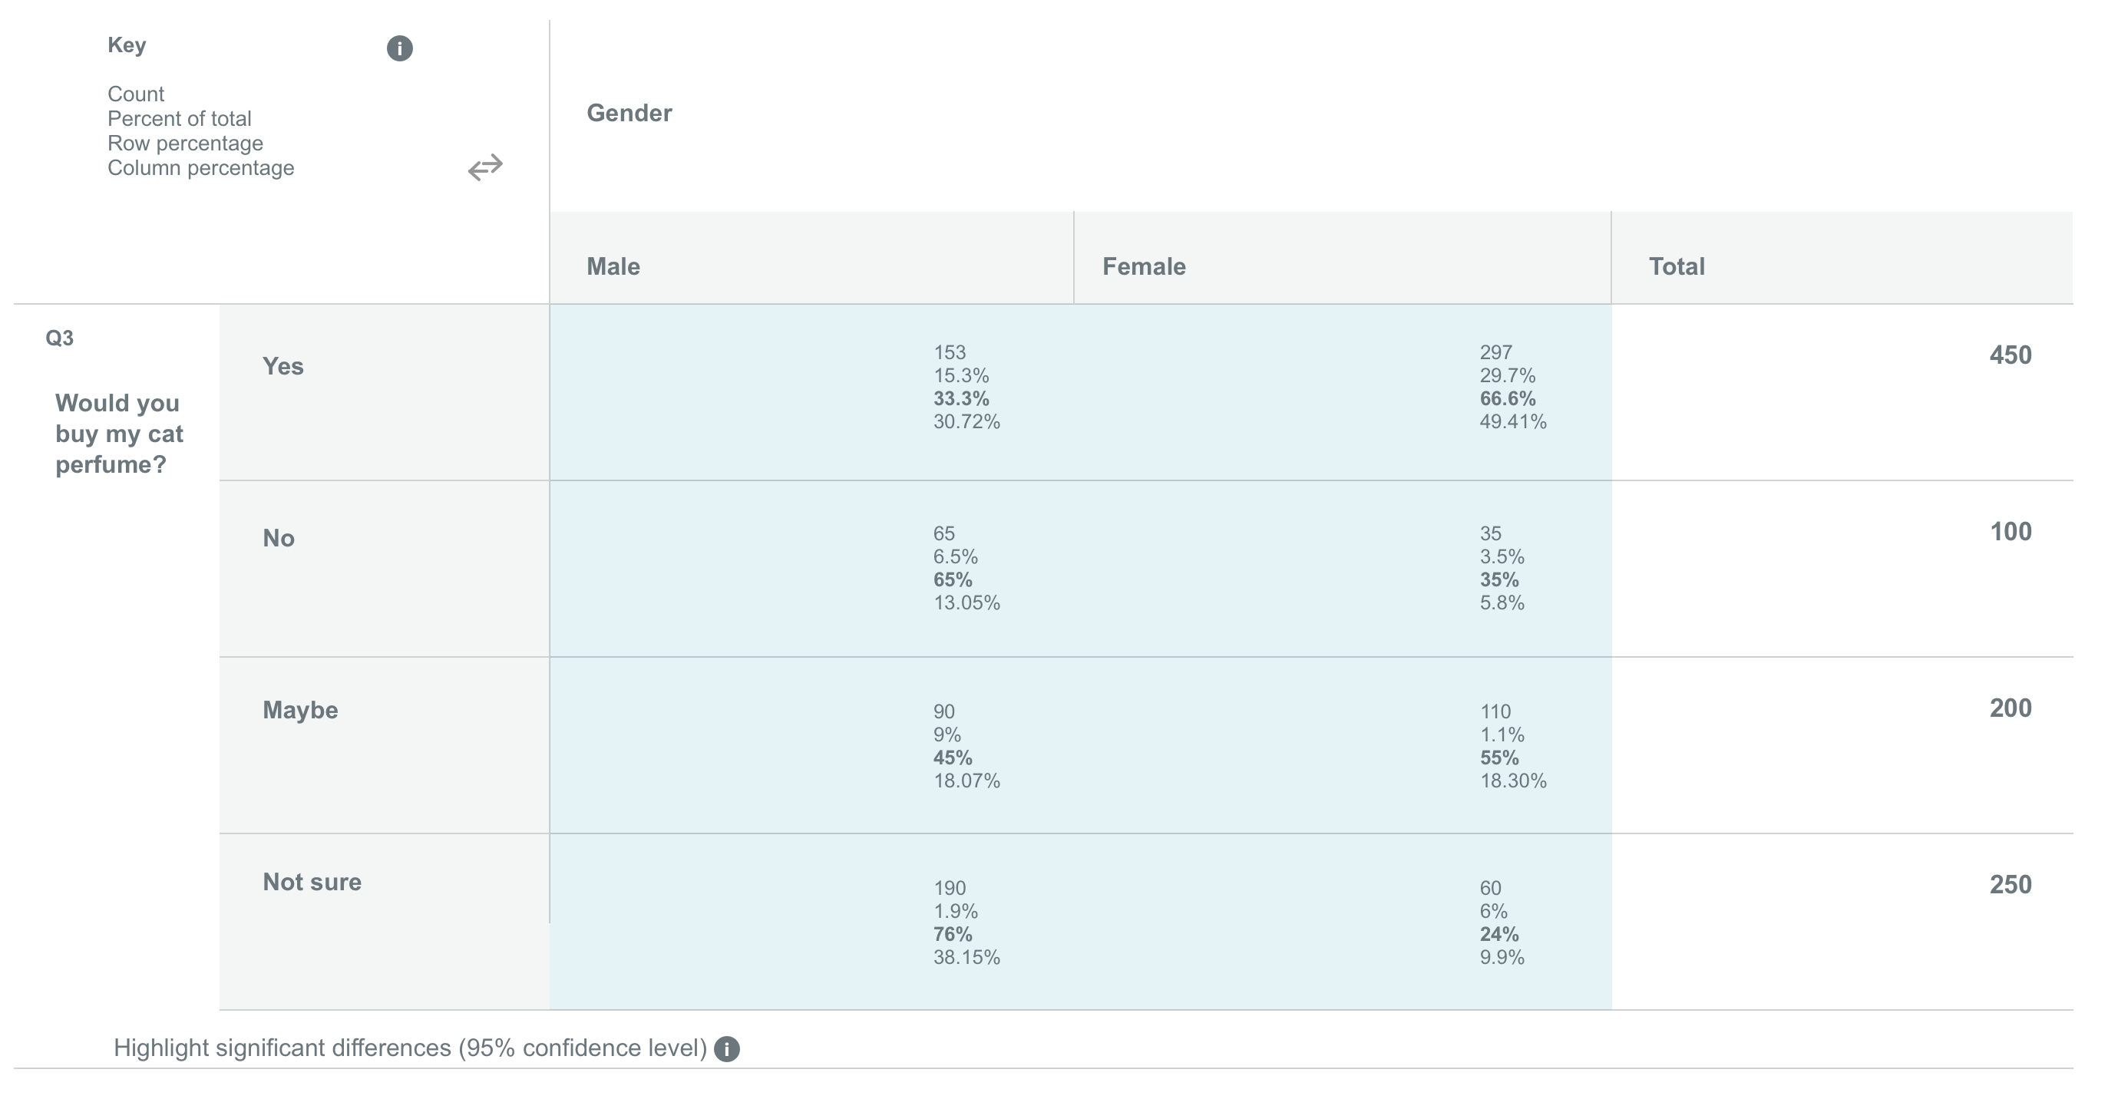
Election Polling
Non-traditional political pollsters are mysteriously more accurate when there is a “gold standard” pollster in the same race, than when there is not a “gold standard” pollster.¹
There is an urge to mold data to fit others’ findings, so that we don’t appear to be a fringe source.²
Polling data should always provide the crosstabs.
¹ https://fivethirtyeight.com/features/are-bad-pollsters-copying-good-pollsters/
² https://fivethirtyeight.com/features/pollsters-say-they-follow-ethical-standards-but-they-arent-so-sure-about-their-peers/
Image: https://www.surveymonkey.com/curiosity/cross-tab-survey-analysis/
Notes:
WILLIAM
<read the notes>
Here’s an example where political pollsters may have altered their data to fit the competition
In a study by 538, non-traditional pollsters (like online surveys or automated systems) were “allegedly” cheating by peeking at “gold standard” pollsters. A “gold standard” poll is a live phone call survey. Non-traditional political pollsters are mysteriously more accurate when there is a “gold standard” pollster in the same election, and less accurate when there is not a “gold standard” pollster.
So when there was a “gold standard” poll for that election, the non-traditional polls were more accurate.
No “gold standard” poll for a small election in Alaska? The non-traditional polls were less accurate.
Our picture here is of the “crosstabs” in a political poll. A detailed data table of the polling results, per demographic breakdown, per question. A common response to big or sensational headlines about political poll results should always be, “show the crosstabs”.
Transparency should include not only the “crosstabs” of your results, but a disclosure/discussion of known historical biases.
Your data tells a story – there may be a tendency to want manipulate the data to fit the story you want to tell. How can you “show the crosstabs”, show the detail and the proof, in your work?

Slide 23
Disclosure of Bias
“Every scientist should therefore be aware of all potential sources of bias... If deviation is still present, authors should confess it in their articles by declaring the known limitations of their work.”¹
¹ https://www.ncbi.nlm.nih.gov/pmc/articles/PMC3900086/
Notes:
C
This is a quote from an NIH study.
<read quote>
Failure to provide that transparency begs accusations of a biased interpretation.

Slide 24
Apple Credit Card (2019)
Men were given higher credit limits.
Women’s income inequality provided a historically biased look at gender.
“No one from Apple seemed able to describe how the algorithm even worked, let alone justify its output. While Goldman Sachs, the issuing bank for the Apple Card, insisted that there isn't any gender bias in the algorithm, it failed to offer proof.”¹
¹ https://www.wired.com/story/the-apple-card-didnt-see-genderand-thats-the-problem/
² https://www.nytimes.com/2019/11/10/business/Apple-credit-card-investigation.html
Notes:
C
<read notes>
Let’s look at an example with biased outcomes and no transparency.
In 2019, Apple issued Credit Cards and men were given higher credit limits than women, even higher than their wives.
How could this be? Could women’s income inequality be a variable? Women’s income inequality provides a historically biased look at gender.
A quote from Wired Magazine, “No one from Apple seemed able to describe how the algorithm even worked, let alone justify its output. While Goldman Sachs, the issuing bank for the Apple Card, insisted that there isn't any gender bias in the algorithm, it failed to offer proof.”
This is an example of Apple not even being AWARE of their bias, much less disclosing it publicly (which would have been embarrassing).
Apple is now being investigated by regulators.² – so these kind of errors may result in legal implications.
One could be challenged on disparate impact (particularly in employment areas) – we’ll talk about disparate impact a bit later.

Slide 25
Support Your Conclusions
That’s why we’re talking about steroids, censorship, race, facial recognition, Apple cards.
Transparency to how the algorithm works, at least internally in case of competitive Intellectual Property, is key to acknowledging bias in outcomes.
Notes:
C
<read the slide>

Slide 26
Data Collection
Notes:
WILLIAM
Let’s dive deeper into this ethical problem.
We’ve talked about transparency in analysis,
let’s talk about ethics in data collection.

Slide 27
Ethics in Data Collection
“The specific responsibilities of individuals, government, corporations, and the network of friends, partners, and other third parties who may come into possession of personal data have yet to be worked out. The technological trajectory, however, is clear: more and more data will be generated about individuals and will persist under the control of others.” –Big Data: Seizing Opportunities, Preserving Values. Executive Office of the President of the United States, May 2014¹
¹ https://obamawhitehouse.archives.gov/sites/default/files/docs/big_data_privacy_report_5.1.14_final_print.pdf
Notes:
WILLIAM
<read notes>
So this from a report from the White House in 2014, keys here are that
1) data will be collected on individuals, and
2) data will be not be owned by those individuals
What are our ethical responsibilities in collection and ownership of citizens’ data?
Let’s go over a couple bad examples.

Slide 28
Target’s Pregnant Daughter Scandal
Ethical collection: consumer retail shopping habits from Target stores
Unethical use: expectant mother coupons (to a high schooler who’d been hiding pregnancy)
“We are very conservative about compliance with all privacy laws. But even if you’re following the law, you can do things where people get queasy.”¹
¹ https://www.nytimes.com/2012/02/19/magazine/shopping-habits.html?pagewanted=1&_r=1&hp
Notes:
WILLIAM
<read the notes>
You may be familiar with the story about Target’s targeted mailer campaign for expectant mothers and a furious dad, who didn’t know his teenage daughter was pregnant yet.
Quote is from Andrew Pole, the Target statistician who developed the store’s model for predicting and detecting consumer pregnancies, which were then used to target ads to expectant mothers.
<read quote>
Ethical collection, unethical use, resulting in a violation of privacy for a sensitive topic. What if this ad arrived shortly after a miscarriage? It’d be different if Target were, say, sending mailers people about to buy shoes, or toys, or a car, but a pregnancy?
Pole says that even if you’re following privacy laws and regulations, you still may trip over ethical lines.

Slide 29
Facebook + Cambridge Analytica
Unethical collection: Gathered data on 87+ million users without their consent.
Unethical use: Hired by the 2016 Trump Campaign, CA ran “digital operations”.
CA later shared data with Russian proxies for “rumour campaigns” and “attitudinal inoculation”¹, and “psychological warfare.”²
1 https://www.youtube.com/watch?v=Zy16v0oIo3s 2 https://www.npr.org/2018/05/16/611412562/whistleblower-cambridge-analytica-aimed-to-trigger-paranoia-and-racial-biases 3 https://www.vox.com/policy-and-politics/2018/3/23/17151916/facebook-cambridge-analytica-trump-diagram
Notes:
WILLIAM
<read the notes>
Cambridge Analytica gathered the data on 87+ million users without their consent, via what Facebook later labeled “malicious” use of its system. Any user who took their custom Facebook “quiz” also unknowingly allowed CA to access personal data including location for all “friends”. Clearly unethical collection.
<animation>
CA used the data to perform “Digital Operations” to target Trump’s campaign messaging, using the data to set the campaign travel schedule, platform, and to micro-target Facebook users prior to the 2016 election. That’s not necessarily unethical use.
<animation>
But these quotes are from the Cambridge Analytica employee turned whistle blower who testified in the US and UK in 2018.³ CA later shared the Facebook data with Russian proxies for “rumour campaigns” and “attitudinal inoculation”¹, and “psychological warfare.”²

Slide 30
Consent
Where is it recorded that users signed off on the privacy policy?
Where is it recorded that participants asked to be contacted for future opportunities, or on a “do not call” list?
Are we transparent about our use or potential re-use of the data?
Notes:
WILLIAM
<read notes, then slide>
Analysts must be aware of consent mechanisms, both how they were collected, and more logistically, how this data on consent can be incorporated into future analysis.

Slide 31
Control Creep
“Control creep" refers to data that has been generated with a particular purpose in mind but which is repurposed.
For example, harvesting consumer data for research purposes, then selling the data.
Or for example, using genetic data for employment decisions.
¹ https://www.genome.gov/10001732/genetic-information-and-the-workplace-report
Notes:
WILLIAM
Let’s talk more about that “potential re-use” of data.
<read slide, then notes>
Can anyone think of genetic data example that has been identified as having a disparate impact, that is now federally banned for use in hiring?
For example, employers used genetic screening in the early 1970s to identify potential employees who carried a gene mutation for sickle cell anemia, a very expensive and debilitating genetic disorder that is predominant in African Americans. “Those carrying the gene mutation were denied jobs-even though many of them were healthy and would never develop the disease.”
The Americans with Disabilities Act of 1990 put an end to sickle cell trait discrimination in employment.
How about another example

Slide 32
Control Creep
Unethical, potentially illegal re-purposing of financial data
Using financial data for health care marketing is potentially predatory or discriminatory, and vice versa.
Bias from of socioeconomic trends
“Weblining” is the use of financial data to target users for online ads including childcare, housing, health care.¹
1 https://www.researchgate.net/publication/266910451_The_Good_the_Bad_and_the_Ugly_Applying_Rawlsian_Ethics_In_Data_Mining_Marketing
Notes:
WILLIAM
<read notes>
Using financial data for health care research is potentially predatory or discriminatory, and vice versa, where only wealthy patients are told about the latest treatments.
<animation>
This also leads to a relatively new concept of “Weblining”, or the use of financial data to target users for online ads including childcare, housing, health care.¹ This is a play of words on Redlining, which we’ll talk more about soon. Financial data may be predatory if lower income consumers are targeted with subprime lending, high interest credit cards, or high-fee banking advertisements.
We should be aware, and transparent, of potential control creep in data we control.

Slide 33
Disparate Impact
Notes:
CHRISTINE
We’ll talk more about Weblining later, because it can contribute to digitizing an existing Disparate Impact. We mentioned this earlier with the Apple Card algorithm having a disparate impact on women.
Most systems (selection systems especially) are built to intend to discriminate meaning they create distinctions among people.
There’s various laws about discrimination, most notably around employment, housing, public accommodation… There’s two forms of ILLEGAL discrimination:
Disparate treatment (active discrimination towards individuals): intentional and open bias, retaliation, or exclusionary
Disparate (adverse) impact (passive discrimination): towards groups, individuals. You’re sometimes unaware they exist in your systems.

Slide 34
Disparate Impact
Analytical models or predictive models must either account for and be aware of past trends, or become guilty of continuing and institutionalizing past trends.
Your data analysis must expose and control for disparate impact, or contribute to it.
¹ https://www.nytimes.com/roomfordebate/2015/04/27/can-discrimination-exist-without-clear-intent/unintentional-discrimination-is-as-harmful-as-real-bias
Notes:
CHRISTINE
<read notes>
In the case of housing discrimination, the doctrine of “disparate impact recognizes that implicit biases can produce discriminatory results even without intent, and allows for such results to be remedied.”¹
<read slide>

Slide 35
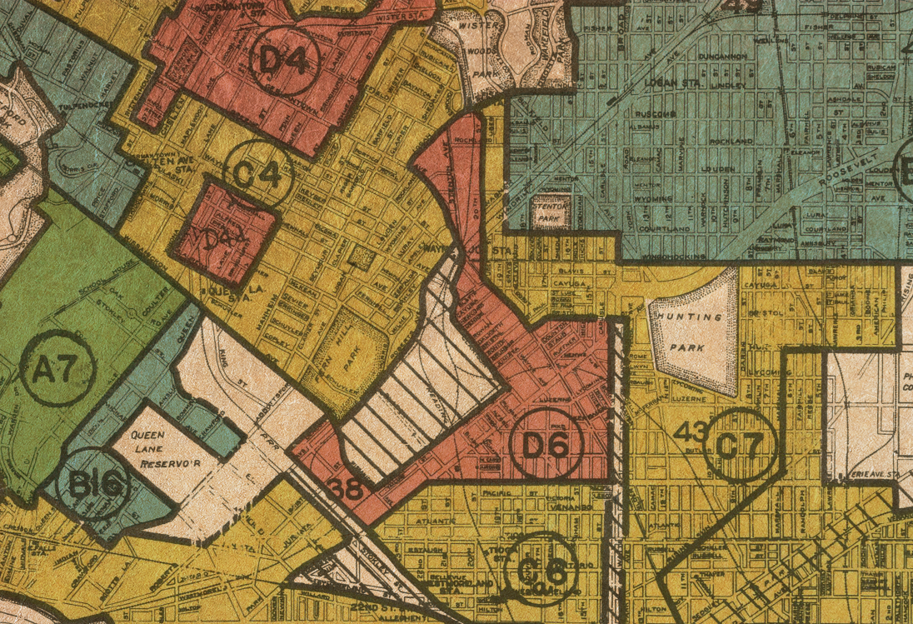
Redlining
Federal Housing Authority Redlining legal 1934-1968.
Outlawed by the Fair Housing Act of 1968, and by the Equal Credit Opportunity Act of 1974.
The Community Reinvestment Act of 1977 required banks to meet the lending needs of low income neighborhoods.
1 Image: University of Richmond digital scholarship lab Retrieved from: https://www.revealnews.org/article/for-people-of-color-banks-are-shutting-the-door-to-homeownership/
Notes:
WILLIAM
<read notes>
Brief history of redlining.
Red lines were literally drawn on maps around “undesirable” minority neighborhoods, marking them as “undesirable” and hazardous for financing. This denied Federal housing authority-insured mortgages to minority families. Literally legalized disparate impact.
This is an actual redlining map from 1937 from Philadelphia, Pennsylvania. Maps like this were used throughout the country. It wasn’t until a series of laws in the 1960s and 1970s that banks were required to meet the lending needs of low income neighborhoods.

Slide 36
Redlining
“Fifty years after the federal Fair Housing Act, African Americans and Latinos continue to be routinely denied conventional mortgage loans at rates far higher than their white counterparts.”¹
1 https://www.revealnews.org/article/for-people-of-color-banks-are-shutting-the-door-to-homeownership/
Notes:
WILLIAM
<read the notes>
The American Dream of home ownership was denied to “Boomer” and Generation X minorities, legally through the 1970s, and that generational gap continues today, fifty years later.
They continue to be routinely denied conventional mortgage loans at rates far higher than their white counterparts.

Slide 37
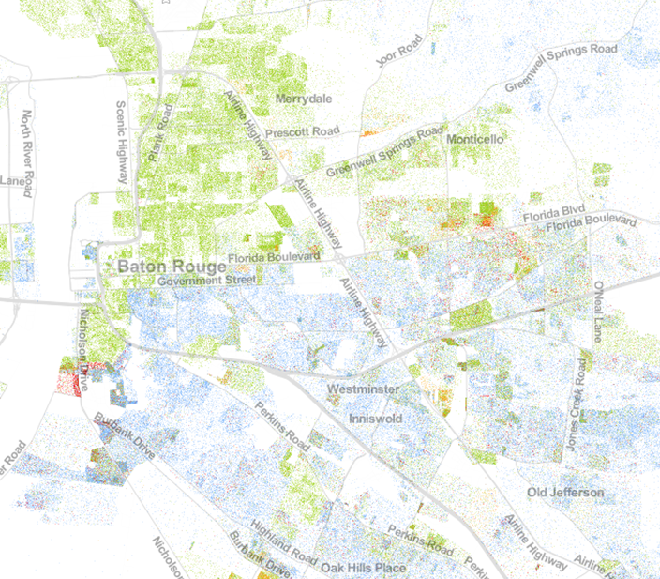
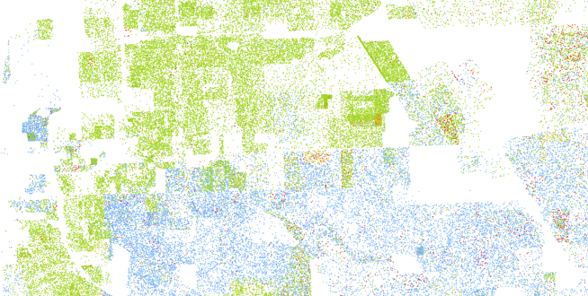
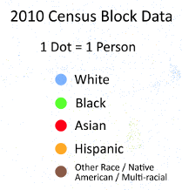
https://demographics.coopercenter.org/racial-dot-map
Notes:
WILLIAM
This is the racial dot map. See if you can spot Florida Blvd on this map, a historical redlining boundary in my home town of Baton Rouge, Louisiana.
If you can’t, try this zoom without the road names.
If you’re a bank, your analysis on market segmentation may be furthering historical racial housing segregation if you are ignoring minority areas for special rate loan offers, ATM locations, service locations, assessments, etc. Even if you aren’t intending to exclude minorities from your financial services, by ignoring 85 years of racial subdividing, you may be extending that trend.
If say, despite your best intentions, your outcome was that 80% of your mortgages were written to whites… in a majority black city like Baton Rouge, your bank could only be judged by its outcomes, not by your best intentions.

Slide 38
Disparate Impact
Only outcomes can measure disparate impact.
Disparate Impact is not based on intentions.
However, 2019 Dept of Housing and Urban Development proposed rules that would make it nearly impossible for banks, landlords, or insurance companies to be sued when minorities are disproportionately denied housing. Companies could blame their algorithm and avoid penalties.^{1,2}
1 https://www.revealnews.org/article/can-algorithms-be-racist-trumps-housing-department-says-no/
2 https://www.nytimes.com/2019/08/20/upshot/housing-discrimination-algorithms-hud.html
Notes:
C
<read slide first>
“The [proposed] rule would overturn 50 years of precedent, upheld by the Supreme Court in 2015, that permit the use of statistical analysis to identify patterns of discrimination.”¹

Slide 39
“Weblining” or Digital Redlining
Collecting data, segmenting based on income, resulting in disparate offers, exposure.
“Social sorting” affects and inﬂuences both the choices and opportunities of proﬁled individuals.¹
Facebook allowed housing ads to target based on religion, race, sex, disability, more.²
Harvard study found discrimination in Google’s Online Ad Delivery.³
¹ https://www.researchgate.net/publication/266910451_The_Good_the_Bad_and_the_Ugly_Applying_Rawlsian_Ethics_In_Data_Mining_Marketing
² https://www.hud.gov/press/press_releases_media_advisories/HUD_No_19_035 ³ https://dataprivacylab.org/projects/onlineads/1071-1.pdf
Notes:
C
<read notes>
“Weblining” or “Digital Redlining” is the segmentation of consumer data based on income. This may result in disparate exposure to online ads and services, like in childcare, housing, or health care.
<animation>
“Social sorting” is the coding and classifying of aggregate data, and “Social sorting” affects both the choices and opportunities of proﬁled individuals. Facebook for example was investigated for allowing housing ads to target based on religion, race, sex, disability, more. This allowed for obvious housing discrimination, which is already illegal.
<animation>
Another example is a study that found discrimination in Google’s Online Ad Delivery. Google Ads featuring the headline “Have you ever been arrested?” were sent more frequently to racially black sounding names than white sounding names.

Slide 40
Arkansas Medicaid coverage algorithm
In 2017 “4,000+ disabled and elderly Arkansans saw their Medicaid benefits cut due to an unannounced rule change.”¹
In 2018, the AR Dept of Human Services was held in contempt of court over its use of the algorithm.²
Eventually, the state legislature cut benefits after a lengthy court battle – the algorithm won.³
¹ https://arktimes.com/news/arkansas-reporter/2017/10/12/dhs-rule-change-threatens-disabled-care?oid=10388695
² https://arktimes.com/news/arkansas-reporter/2018/05/31/archoices-rule-blocked
³ https://arktimes.com/arkansas-blog/2018/12/22/dhs-set-to-impose-medicaid-spending-caps-for-at-home-services-under-archoices
⁴ https://papers.ssrn.com/sol3/papers.cfm?abstract_id=1012360
Notes:
WILLIAM
<read notes>
Another example of disparate impact is a pretty clear case of a bad outcome of an algorithm. In 2017, thousands of disabled or elderly Arkansans lost Medicaid funding for life-critical in-home caregivers.
<animation>
Perhaps the cuts were unintentional at first, but also they were unannounced, implemented without caution or review for disparate impact, and then defended by the state for years. Even once the state was held in contempt by a judge for continuing to use the algorithm.
<animation>
Eventually, the state legislature cut benefits after a lengthy court battle – the algorithm won. This is a cautionary tale speaks to the lack of due process and oversight, sometimes inherent to an “algorithm’s decision”.⁴
If transparency and mitigating bias are our goals, then we must review the outcomes.

Slide 41
AI Misgenders Women and Dark Skin
An MIT study of commercial AI products over-relied on lighter-skinned males for training recognition models.
As a result, the faces of one of the researchers was not even detected, and the task of identifying the genders of African and European parliament members showed a 1/3 failure rate for a 50/50 task.¹
An FBI co-authored study indicates that facial recognition software is less accurate on darker skin.²
¹ https://www.media.mit.edu/projects/gender-shades/overview/
² https://www.perpetuallineup.org/
Notes:
WILLIAM
<read notes>
In another case, three different commercial AI products, from IBM, Microsoft, and Face++, used skewed data samples that overrepresented lighter skinned males, and vastly unrepresented and therefore underperformed when trying to identify women or people with darker skin.
<next>
As a result, the faces of one of the researchers was not even detected, and the task of identifying the genders of African and European parliament members showed a 1/3 failure rate for a 50/50 task.
<next>
Another FBI co-authored study indicates that facial recognition software is less accurate on darker skin.
So when this type of facial recognition is used in law enforcement, and is less accurate on darker-skinned citizens, the potential for a civil rights disaster is high.

Slide 42
Conclusion
Notes:
C
So we know what bias is. We know what it looks like.
We know about how bias can create problems for ethical collection and analysis.
We know how to look for ethical collection and analysis by understanding disparate impact.
We know that disparate impact doesn’t care about your intentions.
What kind of questions can we ask of ourselves and our teams to avoid ethical pitfalls in data analysis and collection?

Slide 43
Preventing Ethical Pitfalls
How anonymous is our data?
Who has access to the data internally? Who has access externally?
Legally, what regulatory environment do the citizens exist in?
Is the data trustworthy, and are its biases understood?
Notes:
C
How anonymous is our data? Do we have the citizens’ consent, implicitly and/or explicitly, for the level of anonymity we have collected?
<next>
Who has access to the data internally? Who has access externally? Does the citizen have access? Is the access revocable?
<next>
Legally, what regulatory environment do the citizens exist in? What are our responsibilities and potential liabilities? (Such as GDPR in Europe, or the California Consumer Privacy Act)
<next>
Is the data trustworthy, and are its biases understood? Do we have enough context to understand its potential outcomes?

Slide 44
“Just as we can envisage machines with increasing degrees of autonomy from human oversight, we can envisage machines whose controls involve increasing degrees of sensitivity to things that matter ethically. Not perfect machines, to be sure, but better.”¹
—Colin Allen
¹ http://opinionator.blogs.nytimes.com/2011/12/25/the-future-of-moral-machines/?_r=0
Notes:
WILLIAM
Colin Allen, a researcher in Cognitive Science and History, said

Slide 45
“Do the best you can until you know better. Then when you know better, do better.”
—Maya Angelou
Notes:
WILLIAM
To summarize the last hour, how can you mitigate bias and perform data analytics ethically? It’s very simple.
When you know better, do better.

Slide 46
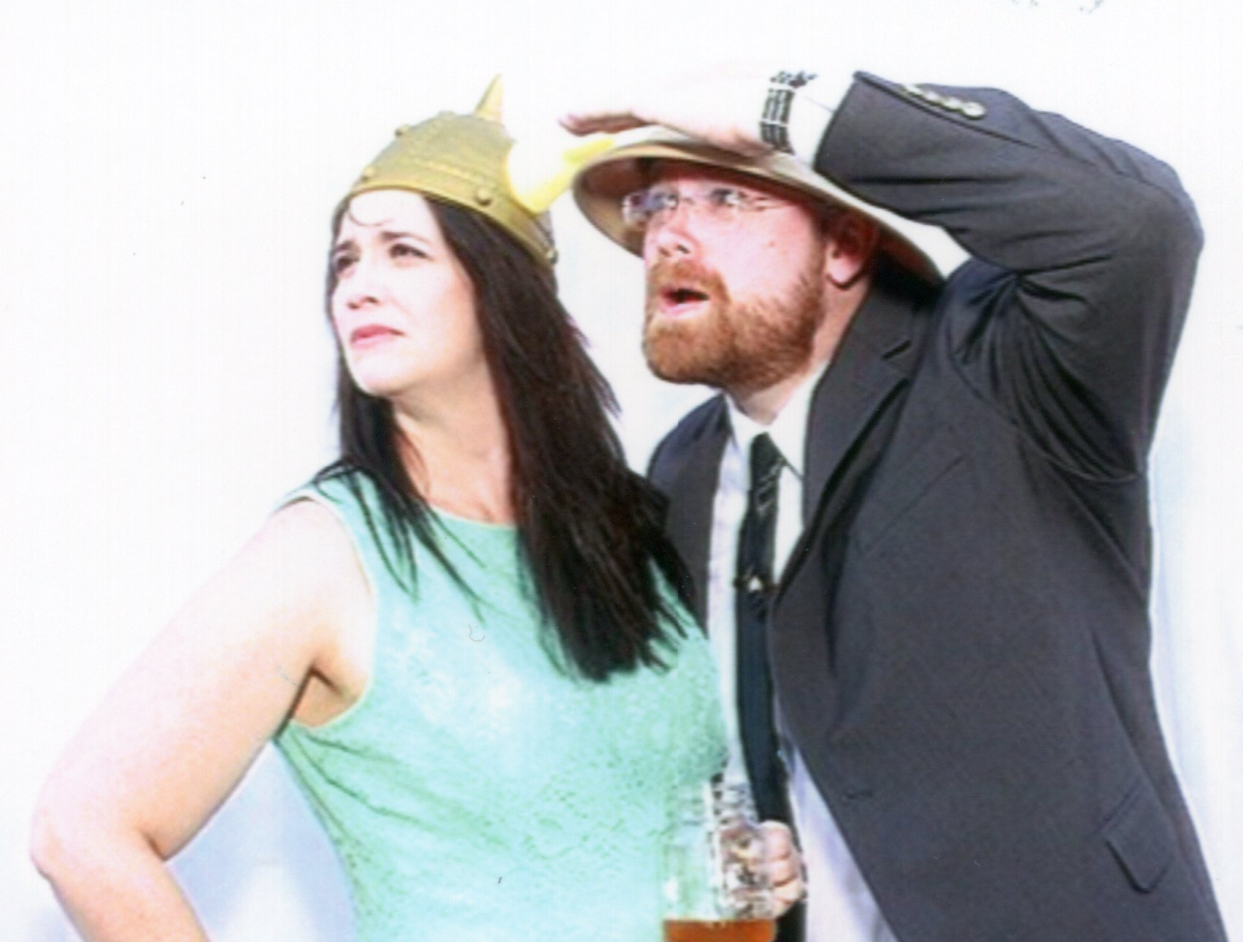
Learn more from William and Christine Assaf
@william_A_dba
SQLTact.com
@hrtact
HRTact.com
Notes:
[Moderator Part]
The moderator’s script will be added in this section after deck submission.

